Slide 1
Update on the UN conference on marine biodiversity of areas beyond national jurisdiction (BBNJ)
Information session for IMO Member States, 21 June 2019
Dorota Lost-Sieminska Deputy Director/Head, Legal Affairs Office, LED
Fredrik Haag, Head, Office for the London Convention/Protocol and Ocean Affairs, MED

Slide 2
Background
2015: UNGA decides to develop an international legally binding instrument on BBNJ, following almost a decade of discussions
Objective: Conservation and sustainable use of marine biological diversity of areas beyond national jurisdiction
Focusing on five main areas:
Marine genetic resources (MGR);
Area-Based Management Tools (ABMT);
Environmental impact assessments (EIA);
Capacity-building and the transfer of marine technology (CB&TT);
Cross-cutting issues: institutional arrangements, the clearinghouse mechanism, general elements, principles and approaches and international cooperation

Slide 3
Background, continued
In 2017, the General Assembly decided to convene an intergovernmental conference (IGC), to develop the instrument
The Secretariat has participated throughout the preparatory phase leading up to this conference (since 2008)
2016-2017: Preparatory Committee (four sessions). Secretariat attended, providing written input, statements and organized side-events (jointly with Member States and ICS) to inform of IMO’s work

Slide 4
Background, continued
The first IGC session took place in New York from 4 to 17 September 2018, and the second from 25 March to 5 April 2019
The third IGC session will take place from 19 to 20 August 2019, and the fourth session in the first half of 2020
All UN Member States are represented at the Conference and the negotiations are undertaken between the representatives of those States
Groups of States (such as Group of 77, African Group, SIDS) play a big role in the negotiations
IMO, same as other organizations, like FAO, IOC, ISA, have an observer status at the Conference

Slide 5
Summary of the first two sessions of the IGC
Addressed and made progress on the main topics:
Marine genetic resources (MGR);
Area-Based Management Tools (ABMT);
Environmental impact assessments (EIA);
Capacity-building and the transfer of marine technology (CB&TT);
Cross-cutting issues: institutional arrangements, the clearinghouse mechanism, general elements, principles and approaches and international cooperation
Agreed that the new instrument should:
be fully consistent with UNCLOS;
not undermine existing relevant legal instruments and frameworks and relevant global, regional and sectoral bodies, such as IMO

Slide 6
Area Based Management Tools under the BBNJ instrument
Area Based Management Tools (ABMTs) relate to the establishment of e.g. marine protected areas (MPAs)
May affect areas established by IMO such as PSSAs, Special Areas, routing measures, etc.
It is important to ensure that measures adopted by BBNJ will not conflict or interfere with measures adopted by IMO, as well as internationally established legal framework on navigation rights

Slide 7
Area Based Management Tools, continued
IMO has several ABMTs at its disposal, which are already in existence and effectively regulating international shipping:
Special Areas and Emission Control Areas, under MARPOL;
Particularly Sensitive Sea Areas (PSSAs), which can in principle incorporate any IMO measure that it has at its disposal to protect the marine environment; and
Ships’ routeing measures, to ensure safety of navigation and protection of the marine environment

Slide 8
Relevance of the BBNJ instrument for IMO – ABMT cont.
Through IMO (based on the framework and responsibilities set out in UNCLOS) Member Governments have established a comprehensive regime for international shipping, ensuring safety of navigation and protecting the marine environment, which includes several options for area based management tools, all firmly based in globally binding IMO instruments
IMO opposes that ABMTs which fall under IMO’s mandate will be designated by another decision-making body
IMO advocates for no duplication of existing measures
The BBNJ instrument will also regulate cooperation and coordination mechanism between global and sectoral organizations

Slide 9
Environmental Impact Assessments
EIAs are not explicitly referenced in IMO’s regulatory framework in a formal sense. However, the process of evaluating the impacts of activities regulated by IMO are embedded in several ways
The Waste assessment framework under the London Convention and London Protocol:
Sets out procedures for assessing impacts of any proposed activities for dumping at sea
Includes a waste prevention audit, consideration of options, a characterisation of the properties, site selection, assessment of effects, monitoring and permitting
An example of an assessment procedure that is already applied in all waters, through the application of Flag, Port and Coastal State responsibilities (see LP article 9.2)

Slide 10
Environmental Impact Assessments, continued
Formal Safety Assessments (FSA):
FSA’s require consideration of potential environmental damage, clean-up costs, cost/benefit with respect to the environment
See MSC-MEPC.2/Circ.12/Rev.2)

Slide 11
Environmental Impact Assessments, continued
Discussions at the IGC includes a variety of options for possible EIAs under the new BBNJ treaty
Possible list of activities which do not require EIA – shipping (?)
Any new tools developed under the instrument should be complimentary in nature to the existing IMO tools, standards and guidelines, and work in tandem with the existing IMO regime

Slide 12
Environmental Impact Assessments, continued
IMO opposes the direct application of the BBNJ instrument on EIAs under IMO’s framework
If new global standards and guidelines are to be developed – IMO needs to participate to avoid duplication
IMO supports that the Organization should be included in public notification and consultation processes regarding EIA
Ensure that the outcomes do not to disrupt the existing legal framework, and in particular the principles of freedom of the high seas and navigation rights, including “innocent passage” and “transit passage”

Slide 13
Capacity building and the transfer of marine technology
States, directly or through competent international organizations, shall promote cooperation in CB&TMT to assist developing countries in achieving the objectives of the instrument
Promoting technical cooperation constitutes a major part of the IMO’s work, thus IMO should be recognized as one of the competent organizations

Slide 14
Relevance of the BBNJ instrument for IMO – capacity building
The BBNJ instrument may contain a list of needs and activities (currently 40 activities listed)
The list will be updated in response to evolving needs of States and regions
Possible ad hoc working groups/subsidiary bodies to develop the list

Slide 15
CB&TMT – modalities
Modalities: reference to IOC UNESCO Criteria and Guidelines on Transfer of Marine Technology
Create new modalities
Decision to be taken: mandatory or voluntary nature of transfer of marine technology

Slide 16
CT&TMT - funding
Funding mechanism – mandatory or voluntary (?)
Besides existing sources, also:
Operational fund
Endowment fund
Rehabilitation/liability fund

Slide 17
General principles and approaches
Environmental principles and approaches:
Precautionary approach
Ecosystem approach
Conservation and sustainable use of BBNJ
Promoting participation and cooperation
Special consideration of developing States
Common heritage of mankind
Freedom of high seas

Slide 18
General principles and approaches cont.
Principles applied to MGR:
the freedom of high seas shall govern the provisions for access to MGRs while the common heritage of mankind shall govern their exploitation
Principles applied to ABMT:
necessity;
proportionality and balance between conservation and sustainable use – the use of ABMT can not be excessive and hamper legitimate utilization of BBNJ

Slide 19
General principles and approaches cont.
Principles applied to EIAs:
Due diligence (States shall take reasonably appropriate actions to ensure that EIAs conform to the requirements of the new instrument);
Universal participation (States are required to provide every stake holder with an opportunity to participate in EIA process)
Principles applied to CB&TMT
Needs of different categories of developing States should be taken into consideration

Slide 20
Institutional arrangements - secretariat
BBNJ secretariat:
New independent secretariat
DOALOS
IOC/UNESCO
ISA
The secretariat shall manage the clearing-house mechanism and coordinate consultation with relevant organizations on ABMTs

Slide 21
Institutional arrangements – decision making body
BBNJ decision making body: COP/Council/Assembly
Assembly: all States Parties
Council: elected States Parties
Scientific/technical body (GESAMP)
Other subsidiary bodies
Decision making body will be responsible for cooperation and coordination with relevant global, regional and sectoral bodies such as IMO

Slide 22
Treaty law
Currently: diplomatic conference
Draft treaty to be presented in August 2019
The new instrument will be adopted under UNCLOS
Open to all States
General elements: definitions, principles
Final clauses: depositary, entry into force still to be decided
Relevant global, regional and sectoral bodies will be responsible for the implementation and enforcement where appropriate

Slide 23
IMO Secretariat approach to the IGC
Throughout the PrepCom and the IGC, the IMO Secretariat has contributed to and organized several side events, providing input on IMO's work
Side events organized together with several IMO Member States, ICS and Norwegian Shipowners Association
IMO Secretariat works closely with United Nations and other specialized agencies (e.g. the FAO, ISA, UNEP, IOC of UNESCO and ILO) to coordinate the position and to ensure that the new instrument will not impact or impede the roles and responsibilities of other relevant global, regional and sectoral organizations.

Slide 24
Next steps
The next session (IGC-3) will be held from 19 to 30 August 2019
Will consider a first full draft text of the future treaty (to be made available in July)
The Secretariat will continue to follow the process and participate in the meetings, and will inform IMO Member States of the developments on a regular basis (MSC, MEPC, Council)

Slide 25
Next steps, continued
Need to ensure that any procedures established under the BBNJ instrument are not inflicting on the IMO mandate, its instruments and processes, including any potential disruptions to the existing legal framework (in particular the principles of freedom of the high seas and navigation rights, including “innocent passage” and “transit passage)
Need for the IMO Member States to liaise with their delegations to IGC to ensure that the positions they present at the Conference are in line with their interests at IMO

Slide 26
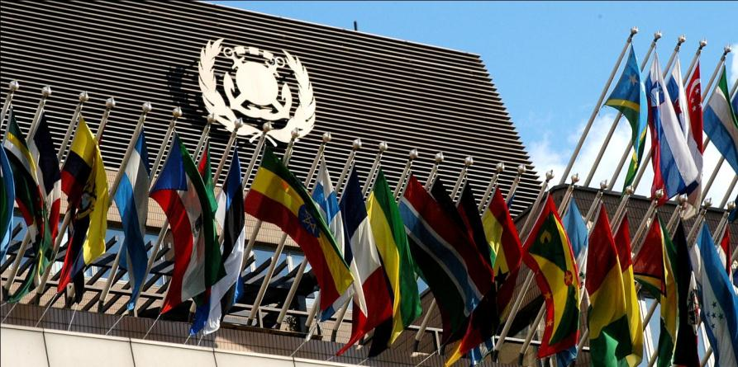
Thank you for listening
www.imo.org

